Slide 1

Fundamentals of Communications Engineering
Department of Communications Engineering, College of Engineering, University of Diyala, 2016-2017
Class: Second Year
Instructor: Dr. Montadar Abas Taher
Room: Comm-02
Course Syllabus:
This course introduces the basics and fundamentals of signals and systems and communications engineering as:
Introduction: The reasons to use communication system, Elements of a communication system, Definitions and terms .
Signal and systems: Types of signals, Fourier transforms, Frequency response of linear system, Time delay, Convolution, Transversal filters.
Noise: Types of noise, Noise figure, S/N ratio, Noise temperature, System noise calculations.
Modulation and Demodulation: AM, FM, PM and PCM modulation and demodulation, modulation indexes, power of modulated signal ,S/N ratio effects, frequency Division Multiplexing (FDM).
Sampling: Base band sampling, Pass band sampling, time division multiplexing (TDM).
Textbooks:
B. P. Lathi, Modern Digital & Analog Communications Systems, 4th edition, Oxford University Press, 1995.
John G. Proakis & Masoud Salehi, Fundamentals of Communication Systems, 2nd edition, Pearson, 2016.

Slide 2
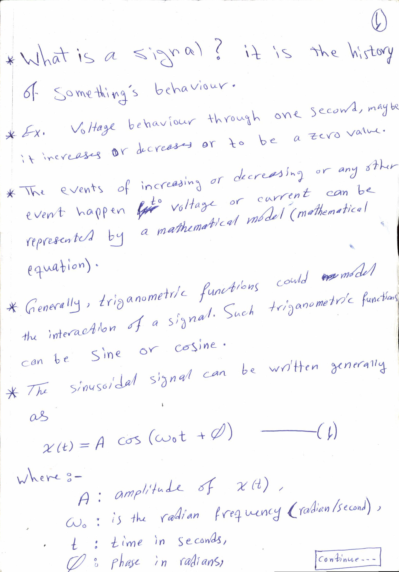

Slide 3
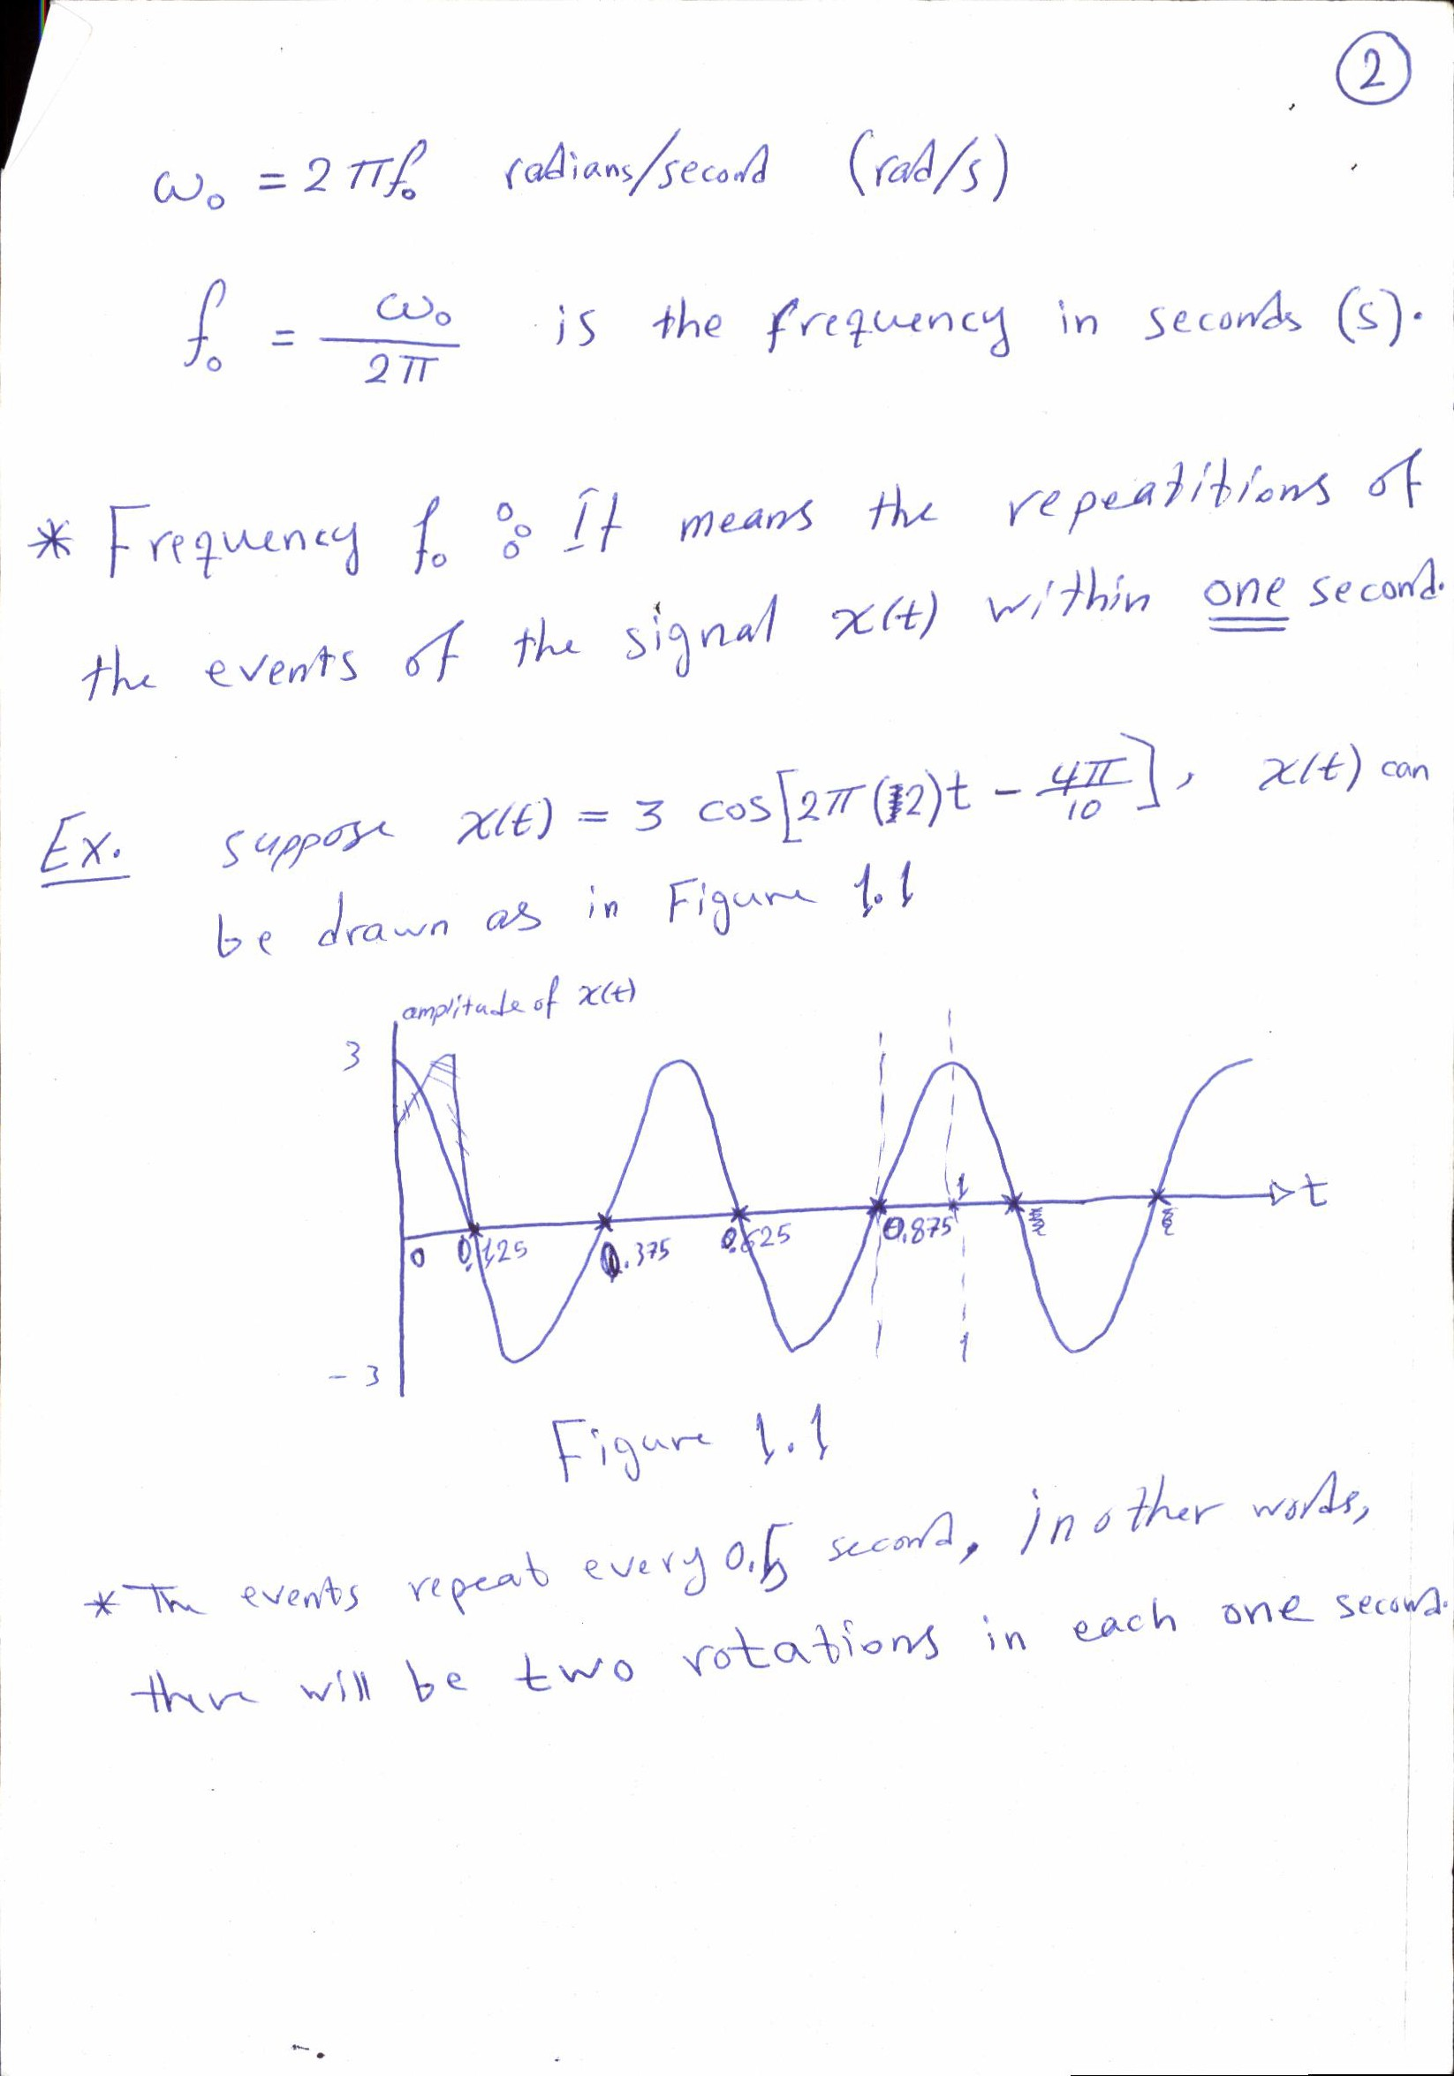

Slide 4
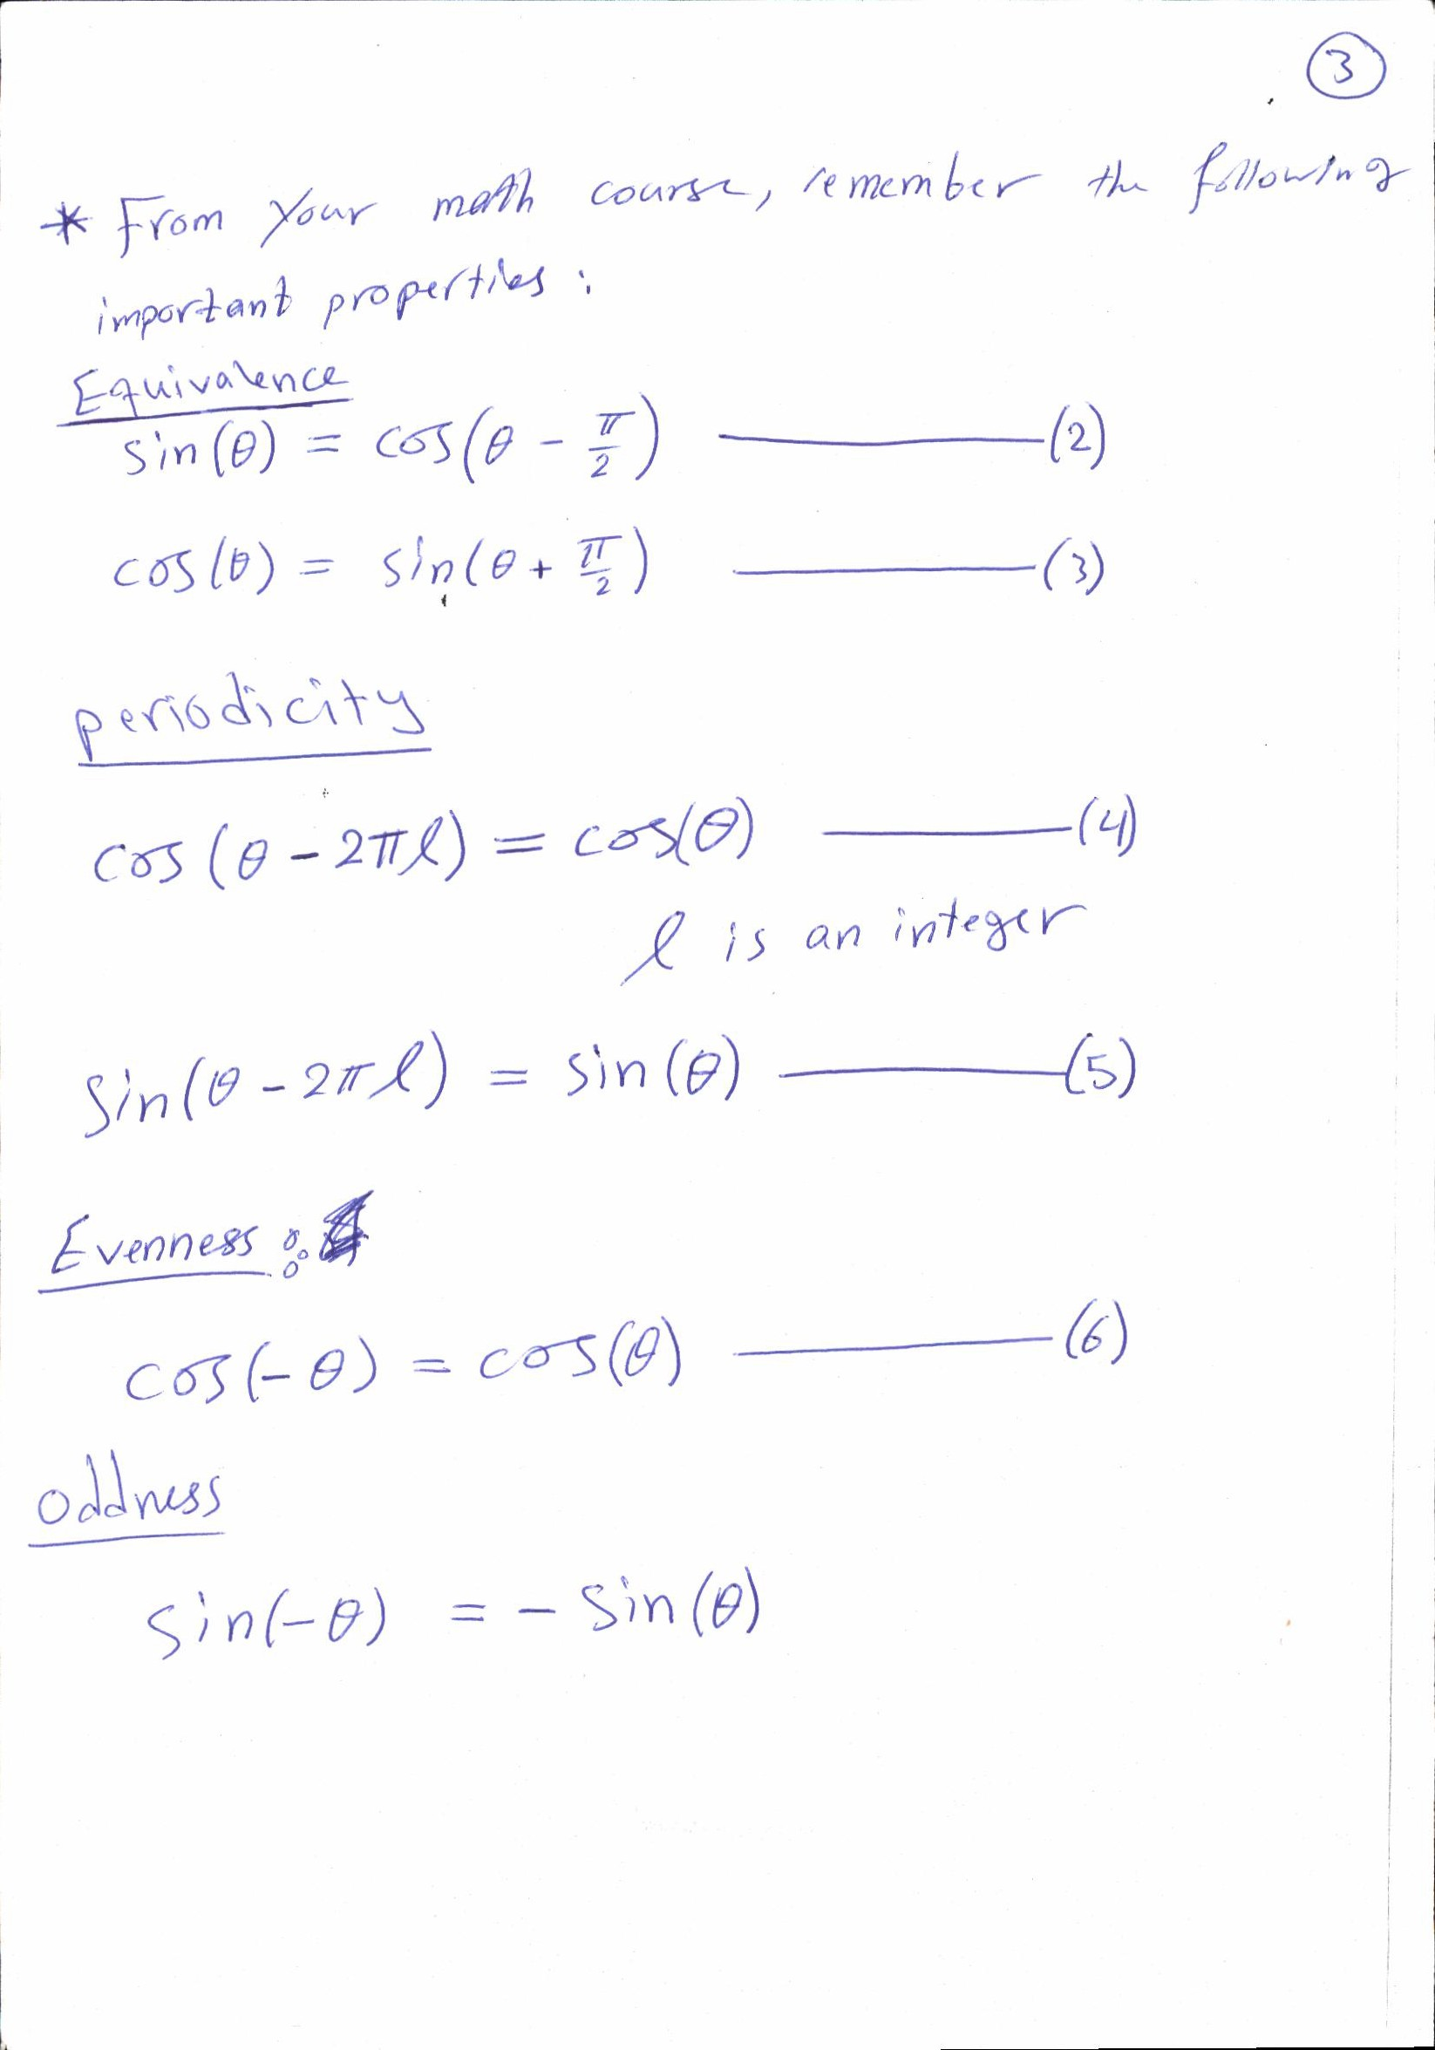

Slide 5
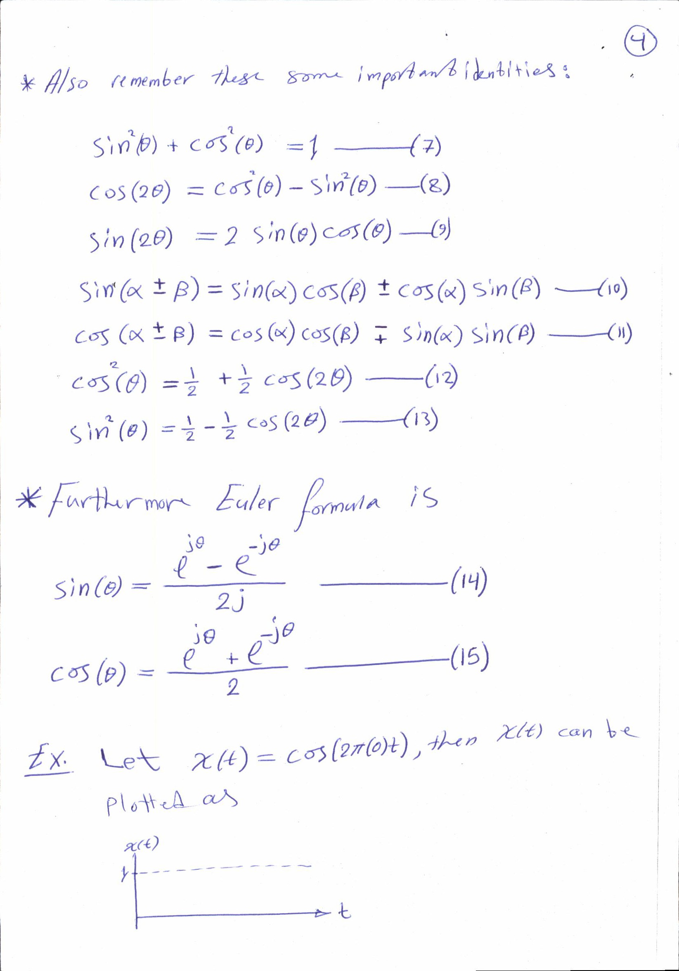

Slide 6
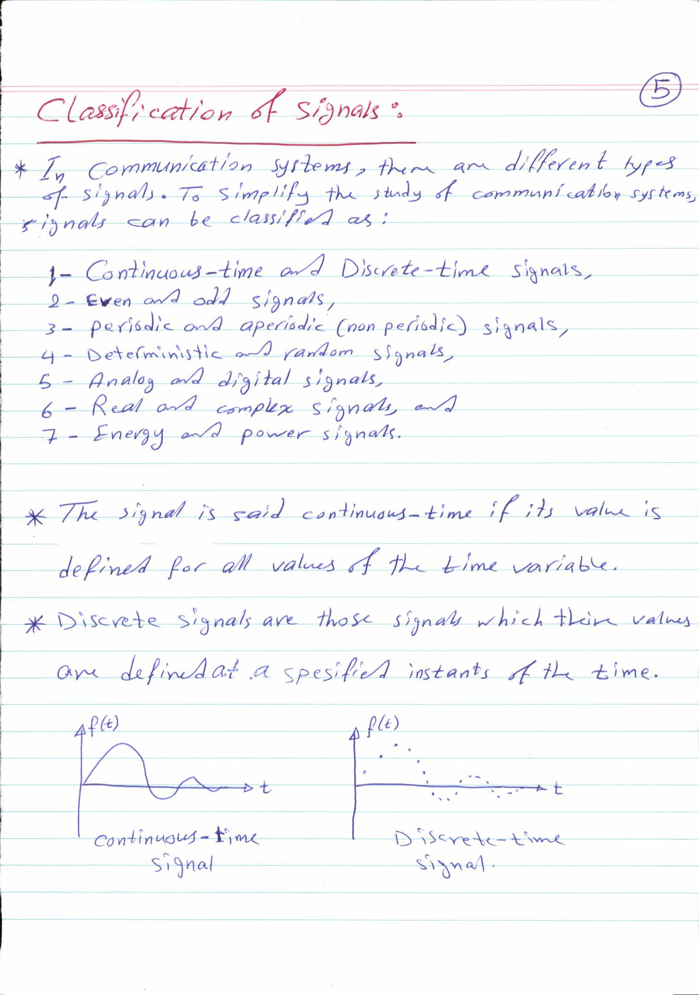

Slide 7
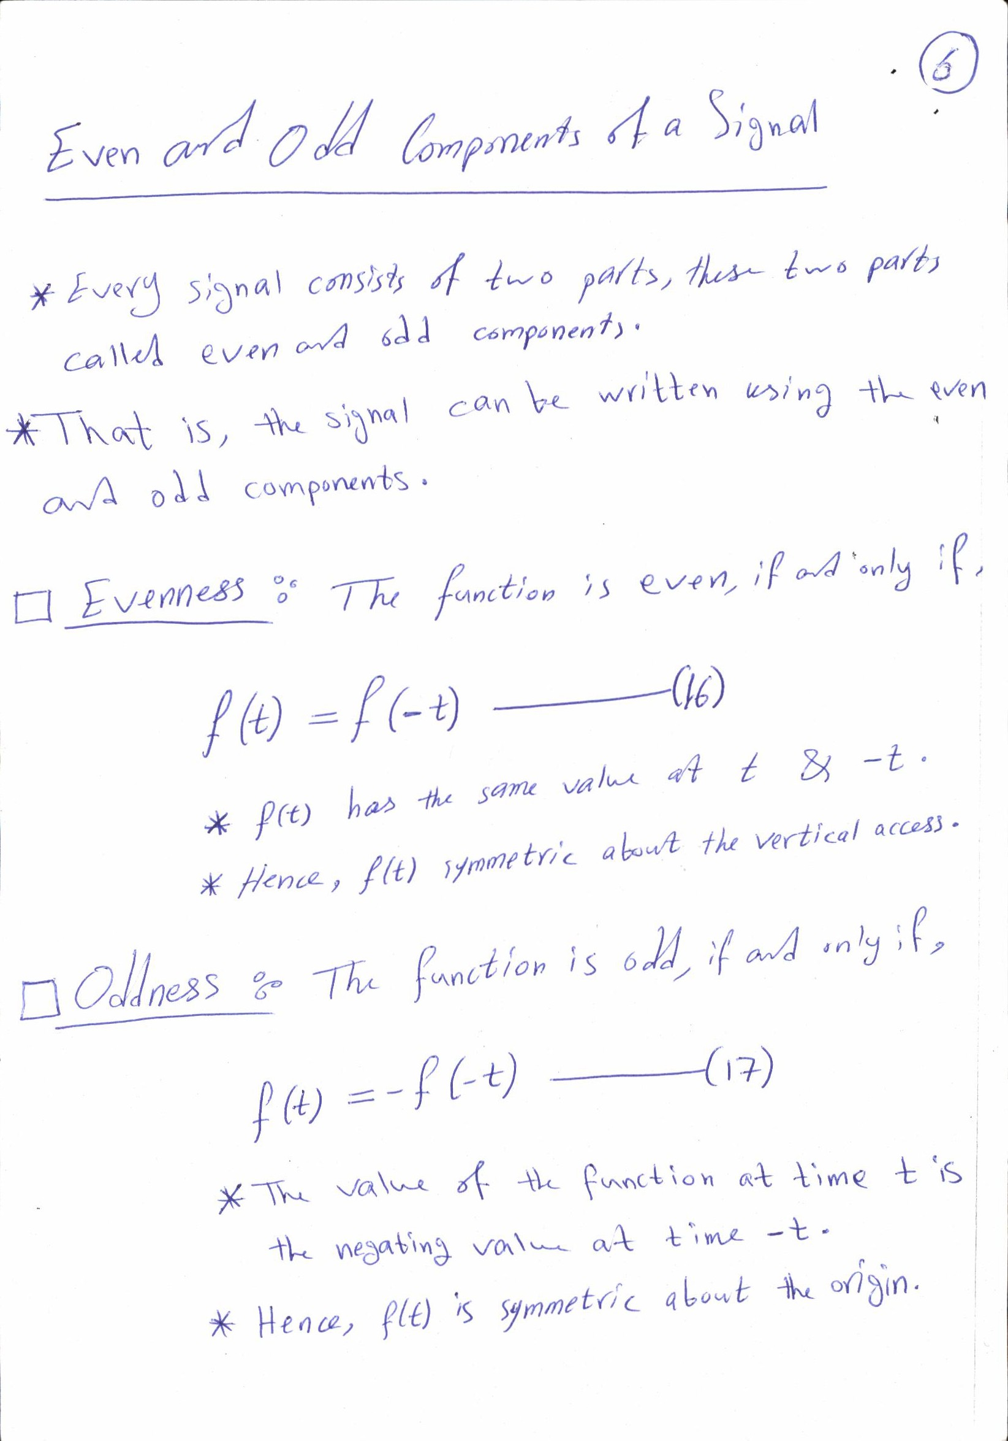

Slide 8
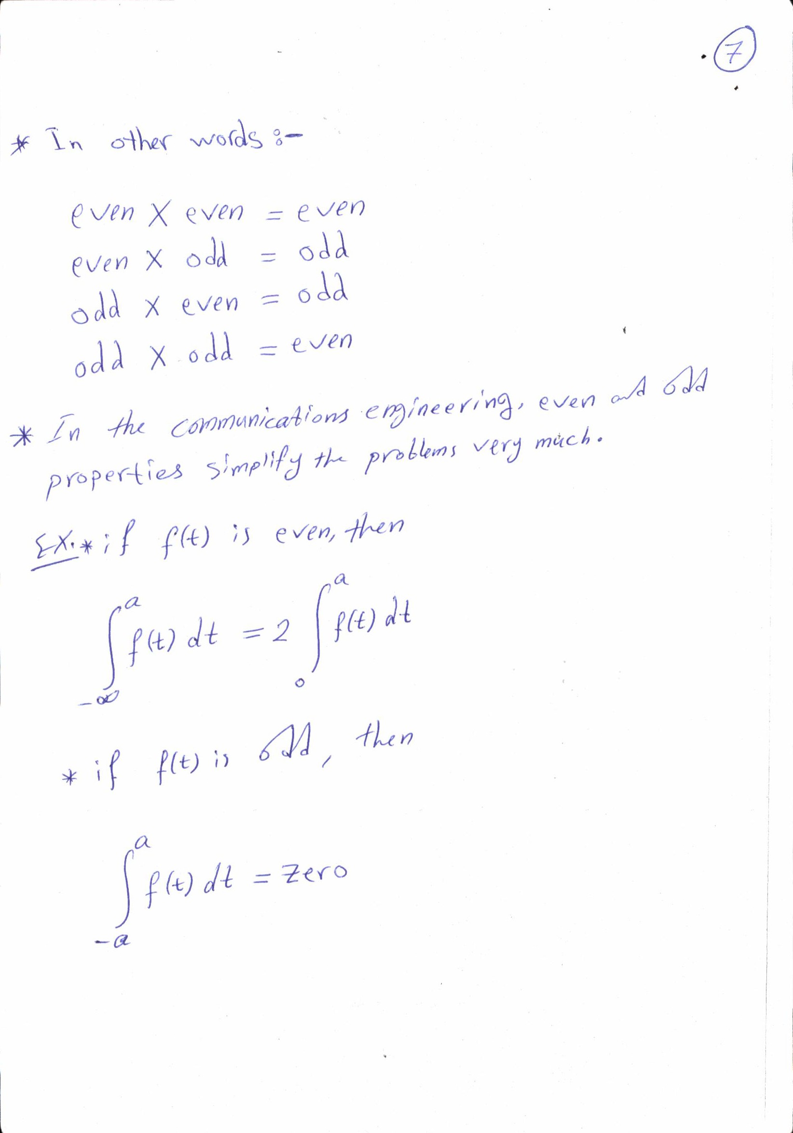

Slide 9
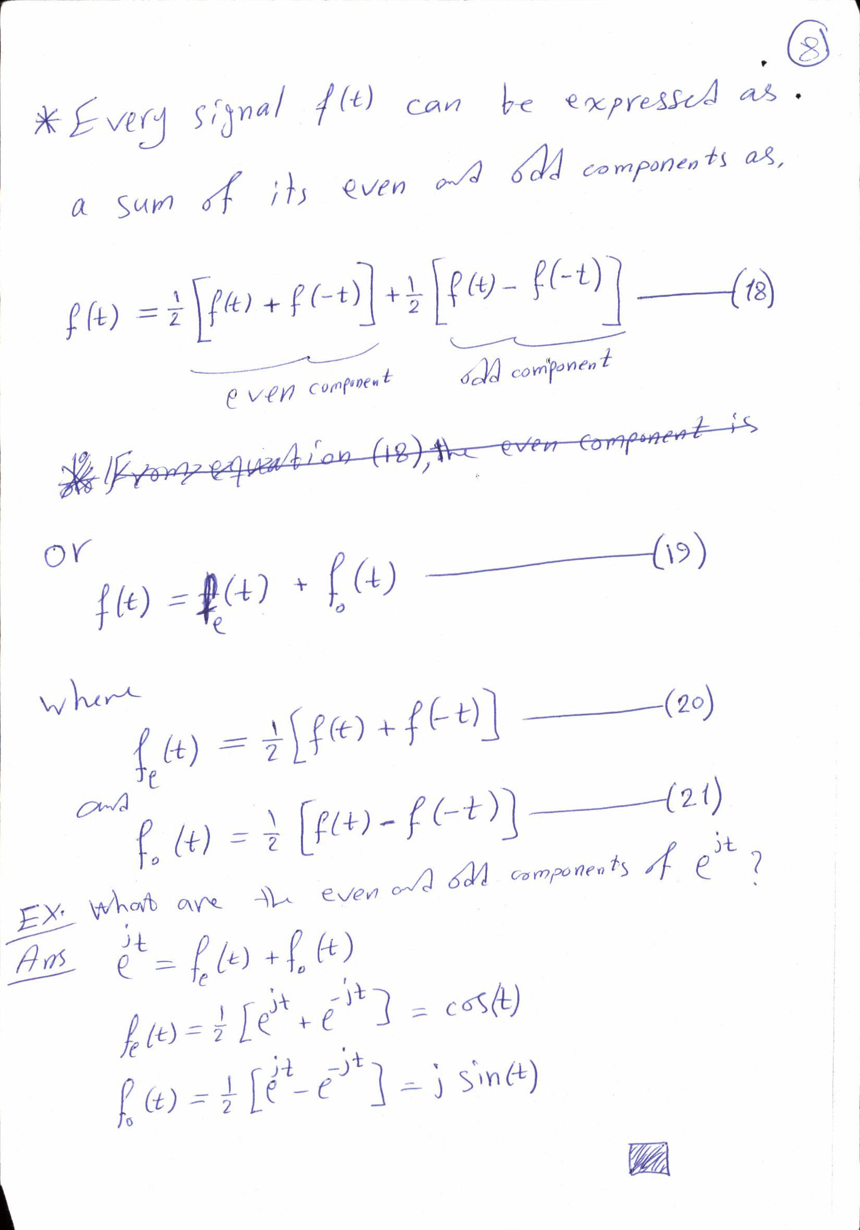

Slide 10
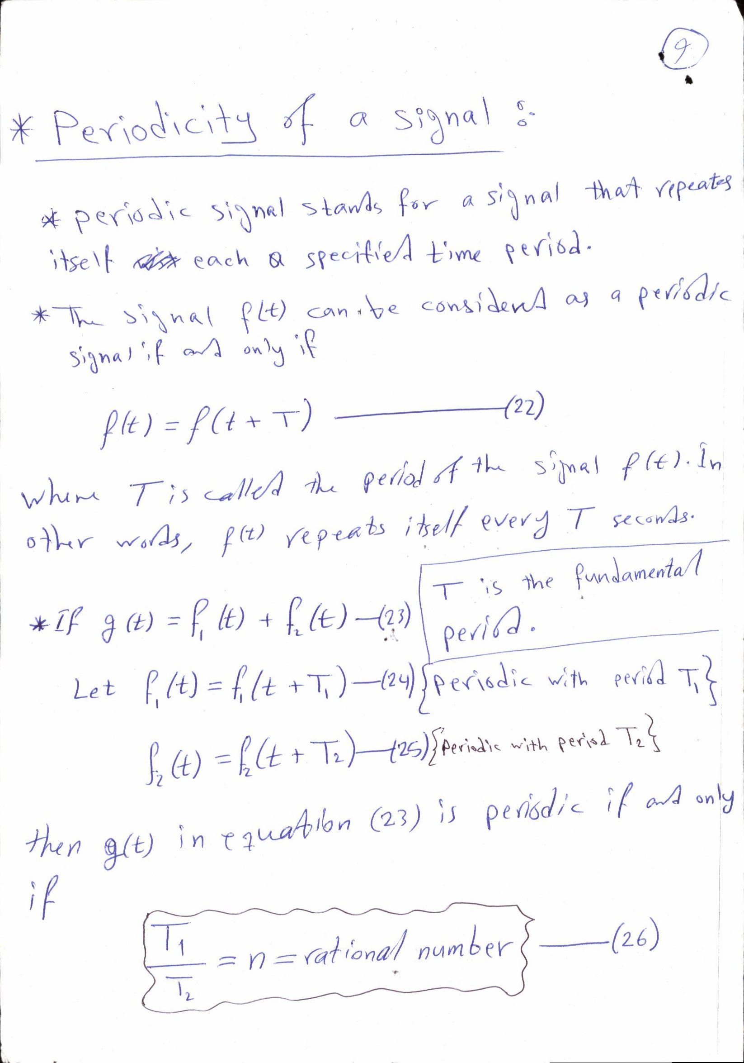

Slide 11
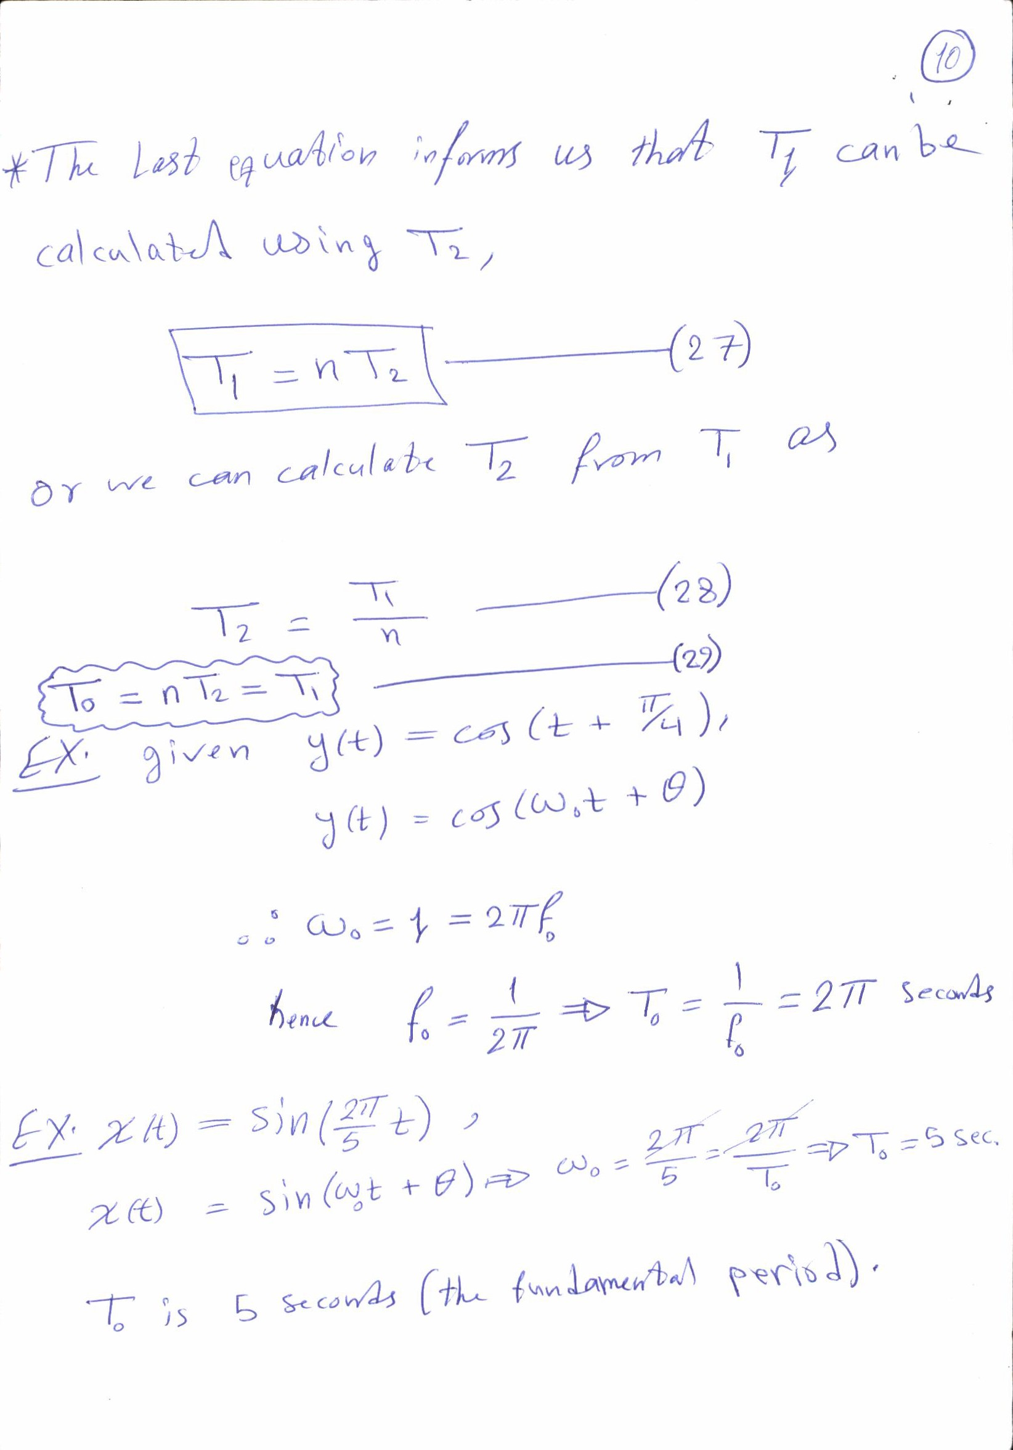

Slide 12
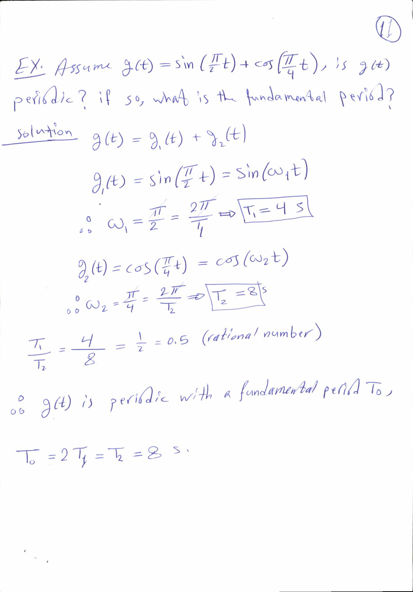

Slide 13
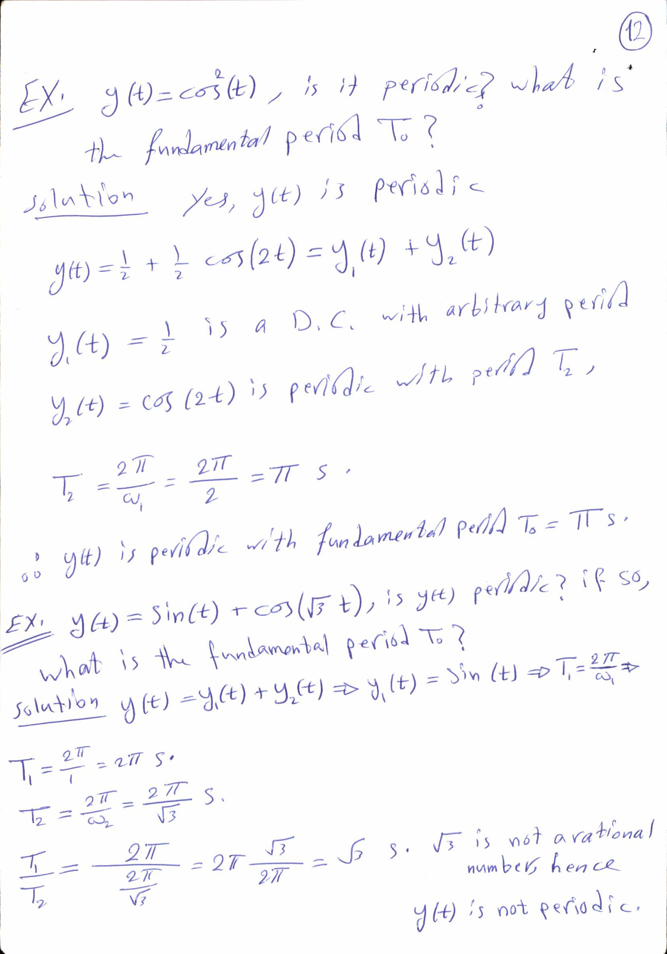

Slide 14
